Slide 1





Automatic Retinopathy Detection Using Digital Image Processing via a Smart Device

Slide 2
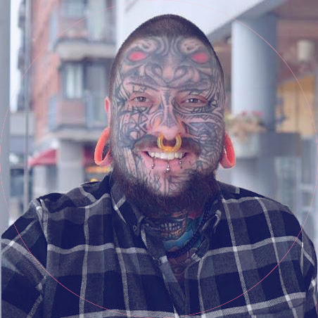
Welcome!
Joey Tatú
BSc (Honours) in Computing
Software Development
15015556
joey.tatu@student.ncirl.ie

Slide 3



Introduction
What is ARD?

Slide 4
Introduction
What is diabetic retinopathy?
What is the ARD app?
Who is ARD for?
What is wrong with current examinations?

Slide 5

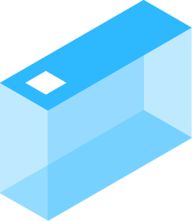
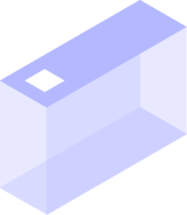
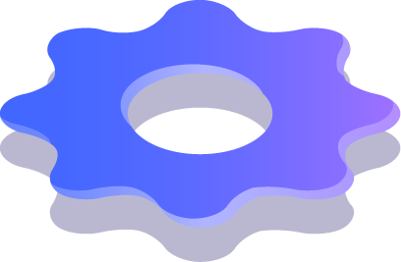
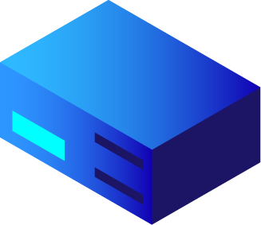



Discussion
Advantages of using ARD
Technology sharing
The future of ARD

Slide 6
Objectives
Simpler
Easy to use
Anyone can use it
Cross-platform results
Medical
Frees up ophthalmologist’s time for more severe cases

Slide 7
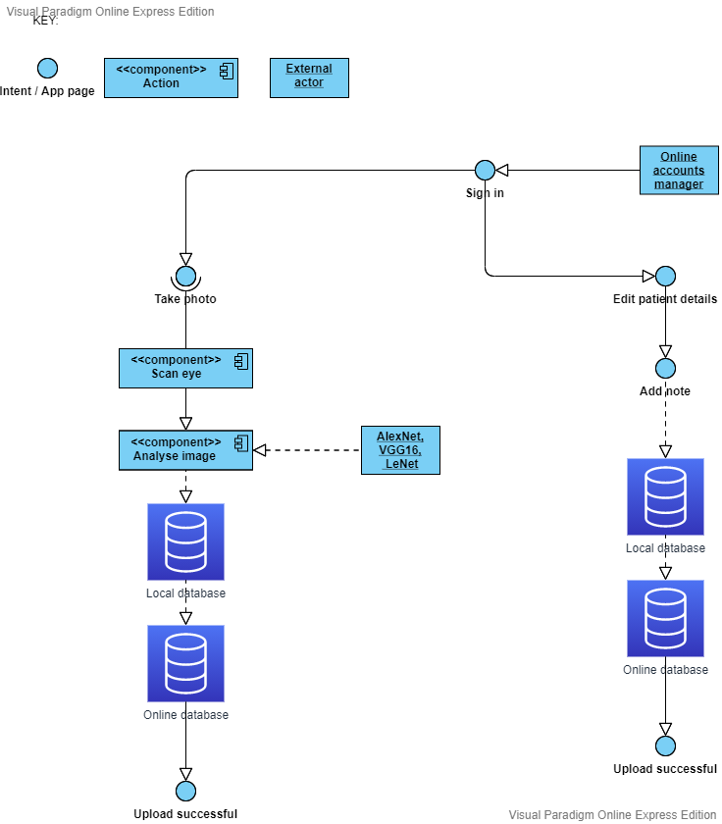
System

Slide 8
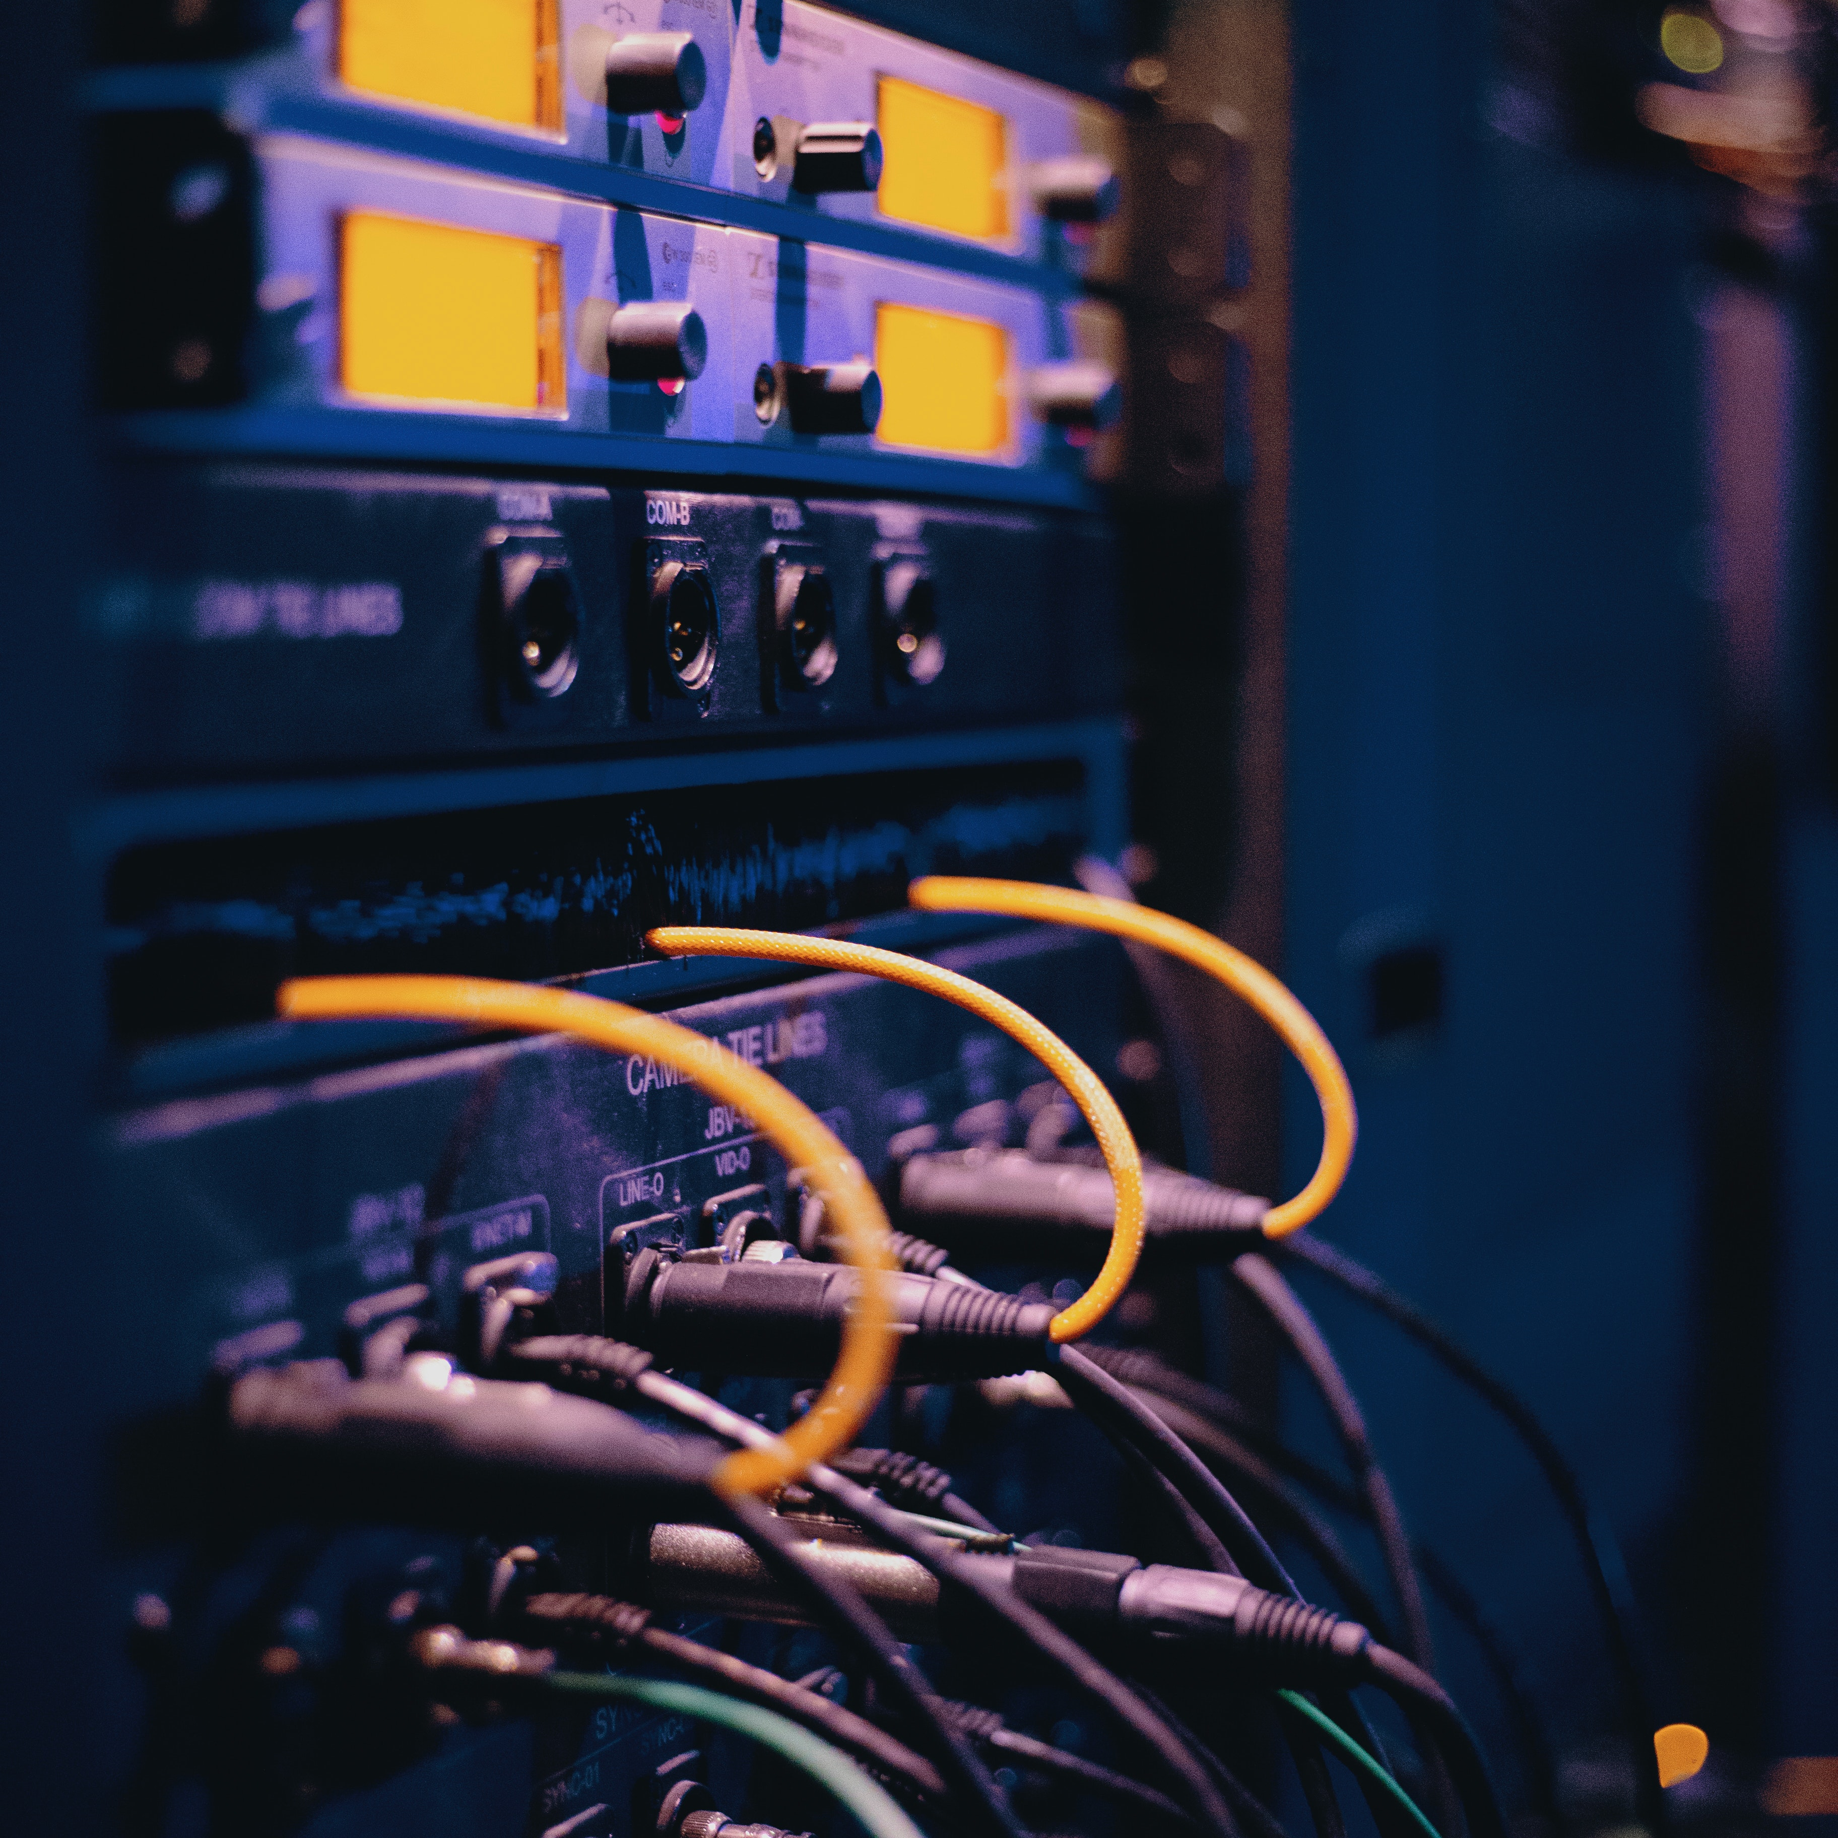
Requirements
Functional
Scan eye
Update patient information
Non-functional
Security
User
Usability

Slide 9
Testing
Usability
Nielsen’s Usability Heuristics for User Interface:
Visibility of system status
Match between system and the real world
Consistency and standards
Error prevention
Recognition rather than recall
Flexibility and efficiency of use
Aesthetic and minimalist design
Help uses recognise, diagnose, and recover from errors
Help and documentation
Unit
Permissions
Security
System
Online connections
Database
Accounts
Patient system
Performance
Response time
Time interacting with other systems
End-user
Would an end-uder be comformable using ARD?

Slide 10
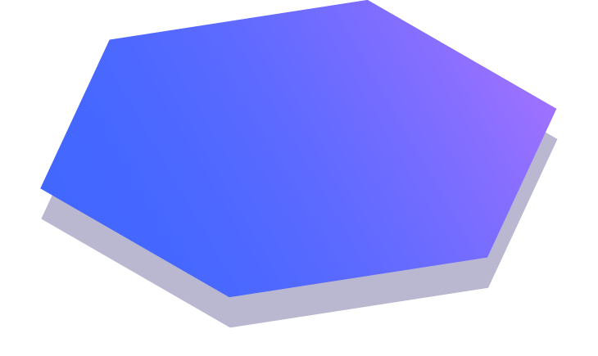
Questions
Which is the most difficult part of your project so far?
How did you go about identifying the requirements for your application?
What is the most challenging aspect of your project which is yet to be completed and how do you plan to go about it?

Slide 11
Thank you!
Joey Tatú
15015556
joey.tatu@student.ncirl.ie

Slide 12
References
Burggraf, C., 2020. Is It Vegan?. [Online] Available at: https://play.google.com/store/apps/details?id=net.isitvegan.androidfree [Accessed 5 November 2020].
HappyCow, 2020. Find Vegan Restaurants & Vegetarian Food- HappyCow. [Online] Available at: https://play.google.com/store/apps/details?id=com.hcceg.veg.compassionfree [Accessed 5 November 2020].
Higgins, J. P., 2016. Smartphone Applications for Patients’ Health, Tucson: The American Journal of Medicine.
Kim, E. J. et al., 2019. Treatment of Diabetic Macular Edema. Current Diabetes Reports, 68(2019), pp. 1-10.
Kirange, D. K. et al., 2019. Diabetic Retinopathy Detection and Grading Using Machine Learning. International Journal of Advanced Trends in Computer Science and Engineering, 8(6), pp. 3570-3576
Leap Fitness Group, 2020. Home Workout - No Equipment. [Online] Available at: https://play.google.com/store/apps/details?id=homeworkout.homeworkouts.noequipment [Accessed 5 November 2020].
National Eye Insitute, 2020. Macular Edema. [Online] Available at: https://www.nei.nih.gov/learn-about-eye-health/eye-conditions-and-diseases/macular-edema#:~:text=Macular%20edema%20is%20the%20build,and%20thicken%2C%20which%20distorts%20vision. [Accessed 18 November 2020].

Slide 13
References
Nielsen, J., 1994. 10 Usability Heuristics for User Interface Design. [Online] Available at: https://www.nngroup.com/articles/ten-usability-heuristics/ [Accessed 10 December 2020].
Oyibo, K., Ifebude, B., Adaji, I. & Vassileva, J., 2019. Investigation of the Perceived Persuasive Features. 4th International Workshop on Personalizng Persuasive Technologies. Tatú, J., 2019. Body Branding Bookings (3B) - Project Proposal, Dublin: National College of Ireland.
Wang, X., Lu, Y., Wang, Y. & Chen, W.-B., 2019. Diabetic Retinopathy Stage Classification using Convolutional Neural Networks, Virginia: Virginia State University.
Wray, M., 2020. Germany, France push to end male chick ‘shredding’ in European Union. [Online] Available at: https://globalnews.ca/news/6420754/male-chick-culling/ [Accessed 2 November 2020].
Special thanks to all the people who made and released these awesome resources for free:
Presentation template by SlidesCarnival
Photographs by Unsplash

